Slide 1


Dashboard Superstore Analysis
By: Rocky Sharaf
Reg no: 11918040
Parent Section: K19PG
Sub: INT217

Slide 2

Content
Excel
Dataset
ETL
Dashboard
Hidden Elements

Slide 3
Abstract
Excel is a software program created by Microsoft that uses spreadsheets to organize numbers and data with formulas and functions. Excel analysis is ubiquitous around the world and used by businesses of all sizes to perform data analysis. Excel features calculation, graphing tools, pivot tables, and a macro programming language called Visual Basic for Applications, and several other features which make Excel a perfect choice to manage and analyze data. My project is an Excel Dashboard. The Excel Dashboard is used to display overviews of large data tracks. Excel Dashboards use dashboard elements like tables, charts, and gauges to show the overviews. The dashboards ease the decision-making process by showing the vital parts of the data in the same window. In this report, I have shared a project where I have done data analysis of a Super-Store data set. The report also presents my learning during my course classes.

Slide 4
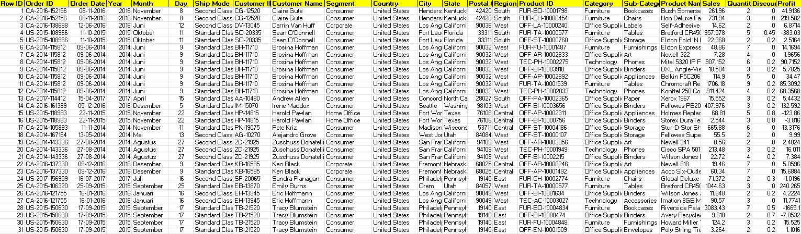
Dataset – Super Store Analysis

Slide 5
Source of Dataset
The dataset is taken from Kaggle. Kaggle is a community of data scientists and data enthusiasts. This platform allows users to find and publish data sets. I have selected a Super Store data set which contains important details of 4 years of store History.
Name – Super Store Analysis
Link - https://www.kaggle.com/juhi1994/superstore

Slide 6

ETL
I have also performed some steps in the ETL process to prepare my data for analysis:
Extraction
Transform
Load
Finally got cleaned Dataset

Slide 7
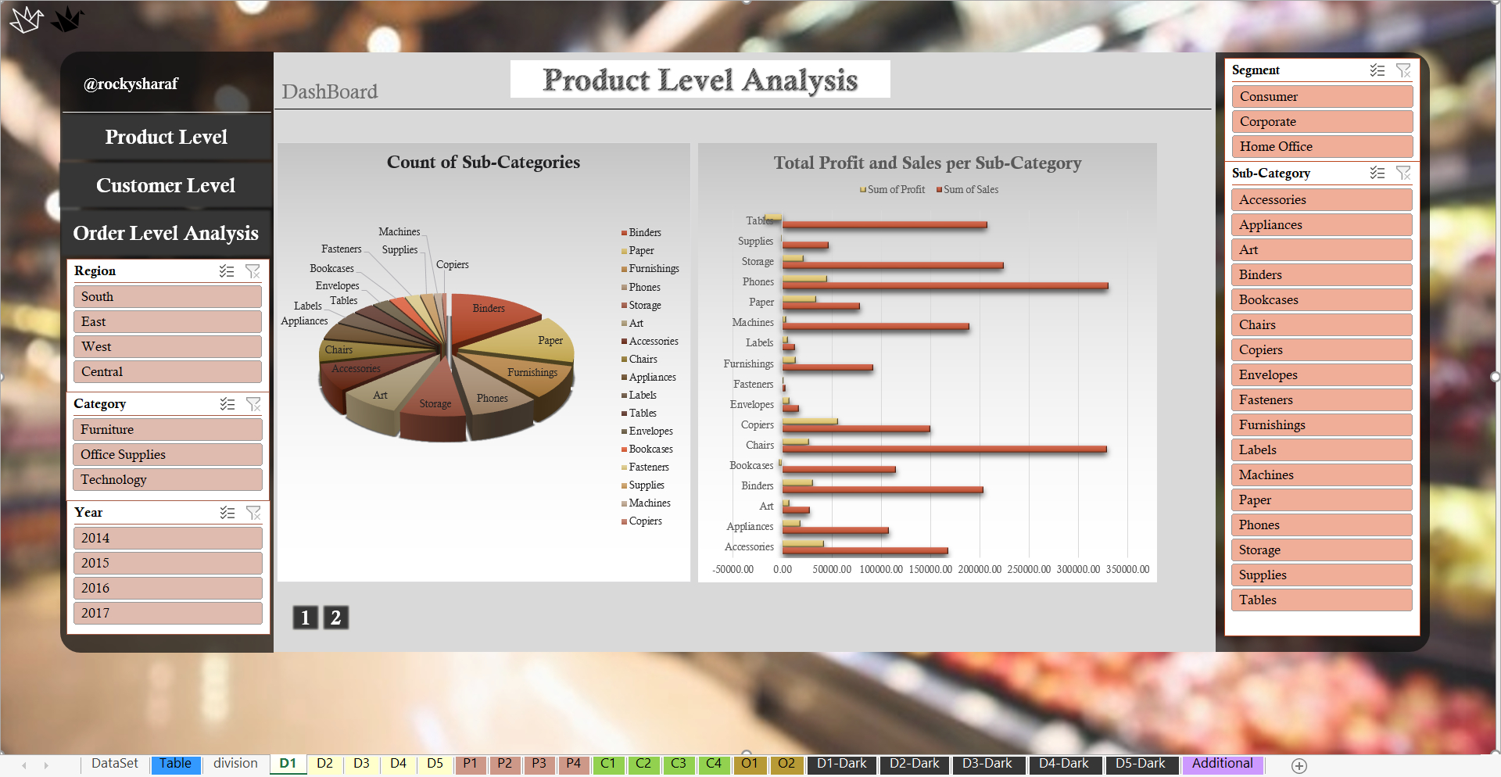
Dashboard

Slide 8
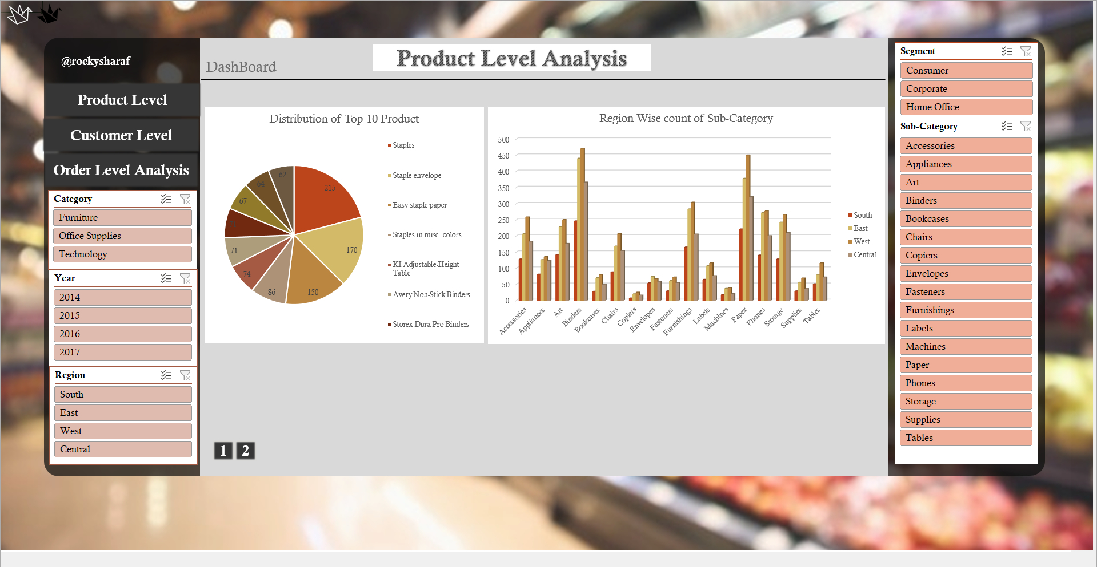

Slide 9
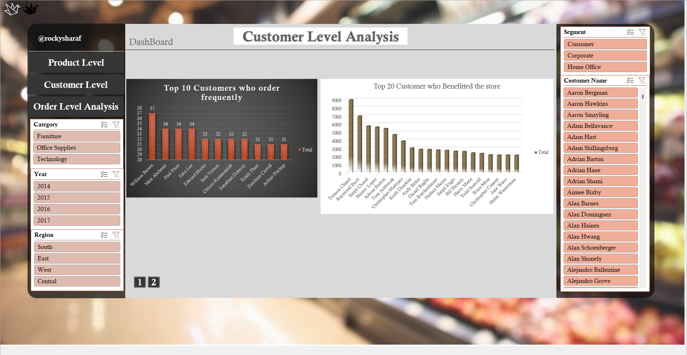

Slide 10
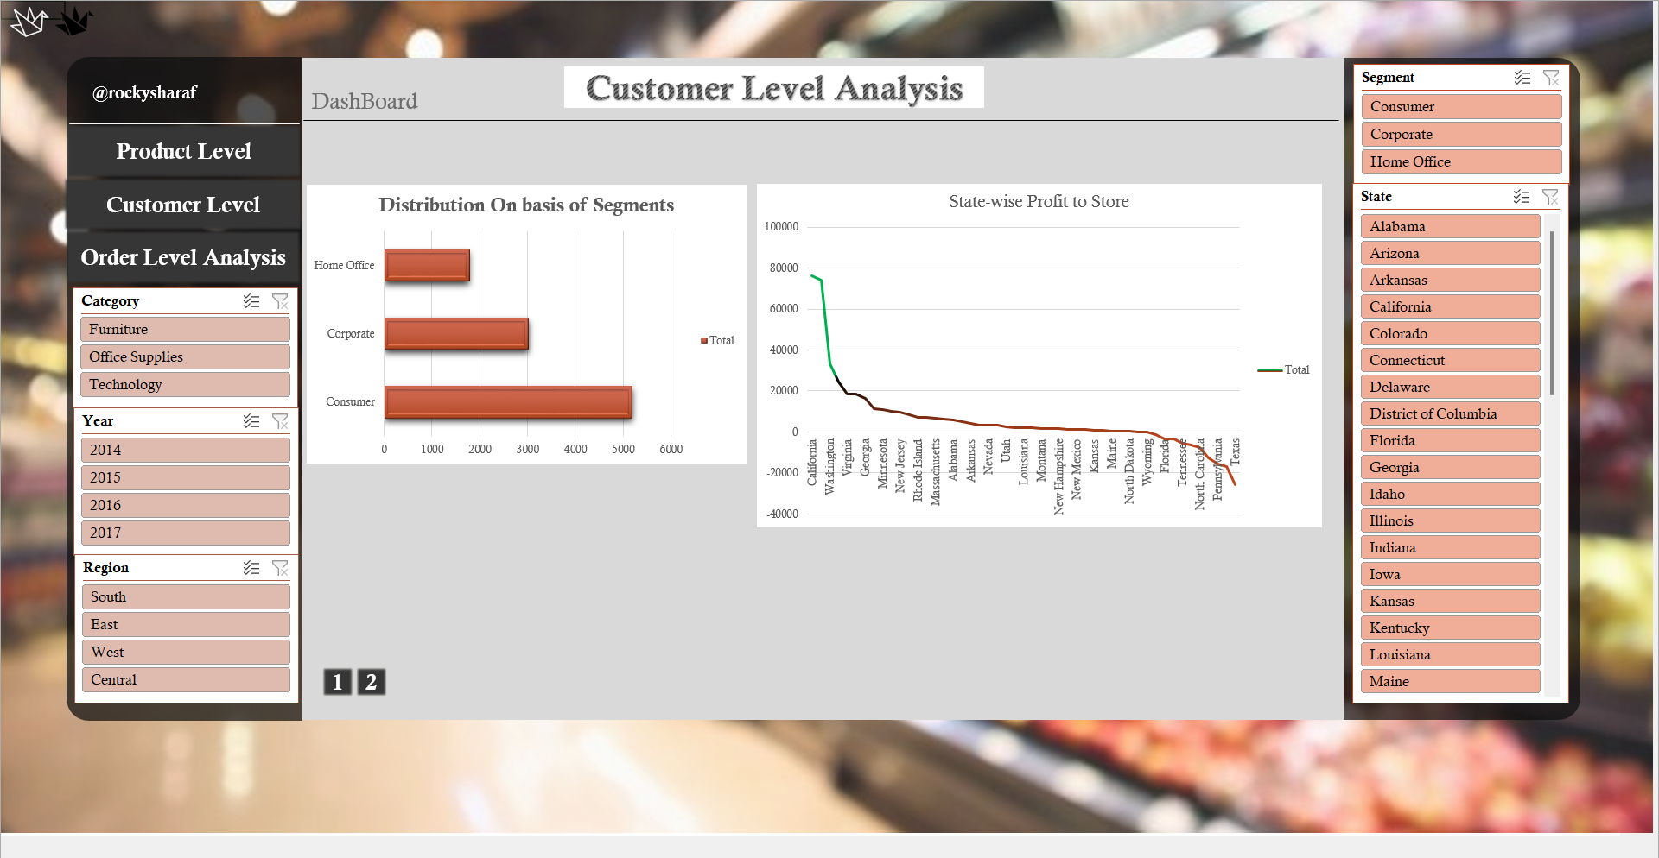

Slide 11
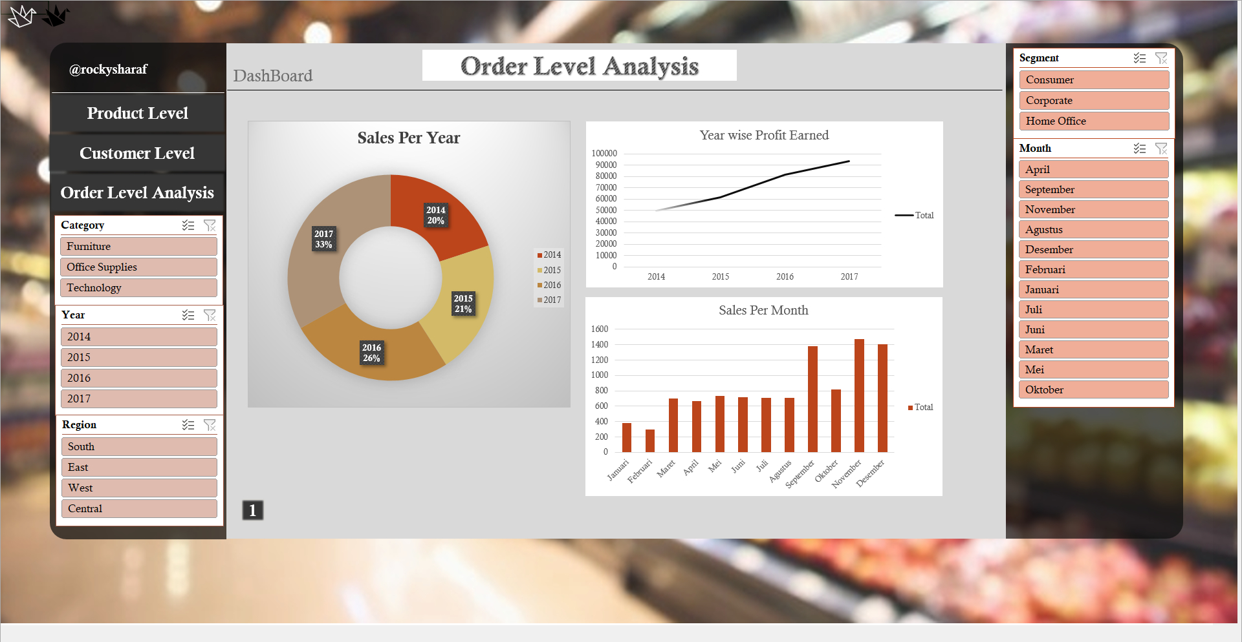

Slide 12

Some Objectives
Which product is mostly sold by super store.
Which product is giving loss, or which is giving profit to store.
In which region, which product is mostly sold.
Which sub-category is on trending from Furniture or Tech.
Who visited the store most frequently?
Whether the person who visit store frequently gives most profit?
Who give most profit to store?
The person who is spending most, is he giving more profit?
Which state is more frequently visiting the superstore

Slide 13


Hidden Elements
This dashboard has many special features some are hidden, and some are visible. Important features are:
Dark/Light theme switch – This switch allows user to change the theme color of the dashboard from white to black (light to dark).
Excel does not provide such features; this switch has been added with a trick. This switch is just an Image, and this image is linked to another copy of this dashboard which has all charts with dark.

Slide 14
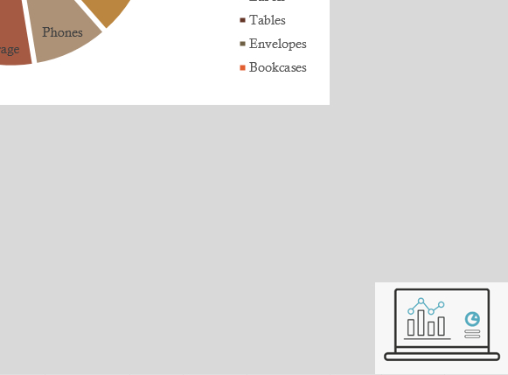
Also, every single sheet also has shortcut links which takes directly to dashboard and Master Sheet.
Back To Dashboard

Slide 15
References
Super-Store Analysis: https://www.kaggle.com/juhi1994/superstore
Excel documentation : https://support.microsoft.com/en-us/excel

Slide 16
Thanks

